Slide 1
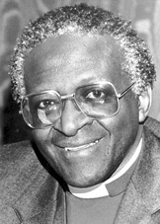
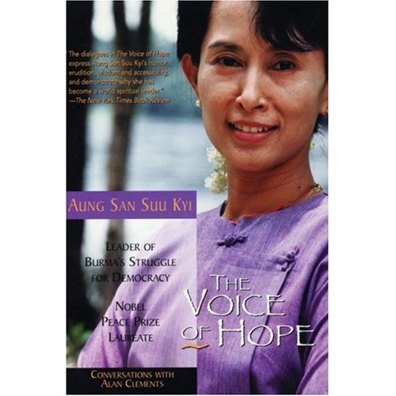
Image management in nonviolent civil society struggle: Movement identity
Tom H. Hastings
Notes:
Tom H. Hastings is full-time faculty for the graduate program in Conflict Resolution at Portland State University and part-time faculty in the Portland Community College Peace and Conflict certificate program. He is on the Governing Council of the International Peace Research Association, past co-chair of the Peace and Justice Studies Association (and current board member), and on the Academic Advisory Board of the International Center on Nonviolent Conflict. He directs PeaceVoice, a program of the Oregon Peace Institute, and has written several books and many articles about nonviolence and other peace and conflict topics. He is a former Plowshares resister and a founding member of two Catholic Worker communities and currently lives in Whitefeather Peace House.

Slide 2
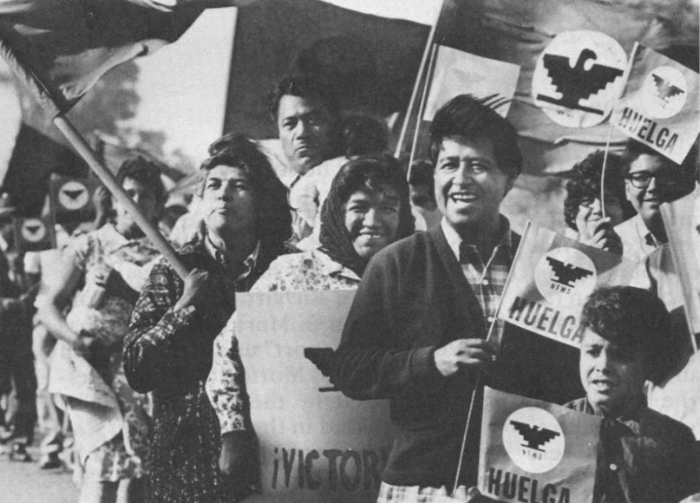
Steps to consider
Understand the power of image
Different manifestations of image
Examining effects of violence on image
How image is created and managed
Media and image
Notes:
Cesar Chavez not only created an image of a completely nonviolent and friendly movement, he and Dolores Huerta enhanced that image by expanding to include workers beyond Mexican migrant workers to other Central American immigrant workers and Filipina/os, creating an inclusive identity. They created an identity of disciplined nonviolence and strategic recruitment of external support. Since they had created the first parts of that image, the external support, even from establishment figures such as Bobby Kennedy, could not be used against them.

Slide 3
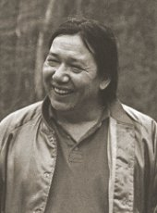
Image importance
Engage widest sympathy
Avoid rationalization for violent repression
Recruit masses
Notes:
Schiwy (2009) describes the interface between image and knowledge in helping civil society engage:
Indigenous media activists of diverse ethnic origins have played an important role
in communicating the culturally diverse peoples of the region. For over a decade and
following a carefully planned strategy, they have used digital video technology in
order to strengthen cultural traditions. CAIB (Coordinadora Audiovisual Indı´gena
de Bolivia) and CEFREC (Centro de Formacio´n y Realizacio´n Cinematogra´fica)
conceived the National Indigenous Plan for Audiovisual Communication in 1996
(see http://videoindigena.bolnet.bo). The plan, which has remained independent of
the Bolivian State, is supported by all the major indigenous organizations and
peasant unions in Bolivia, that is, by those who have issued alternative proposals
during the Constituent Assembly (Asamblea, 2006).2 As part of the plan, the activists
created a video and community television network that regularly distributed digital
video and multimedia packages to a growing number of villages in the Bolivian
highlands and the transnational Amazon basin. Making use of subtitles and
simultaneous interpreting during scheduled screenings in the villages, indigenous
media activists connect distant rural villages across cultural and language differences
(see Schiwy, 2009, chapter 1). Multimedia packages containing indigenous-made
radio and television shows as well as documentary and fiction shorts have been
instrumental in preparing these communities to actively participate in the public
debate about a new constitution in Bolivia.
Image is always crucial. Rebels in Libya captured British Special Forces who had arrived to help even after rebels told them to stay away. The rebels do not want to be seen as affiliated with the British:
http://news.antiwar.com/2011/03/05/libyan-rebels-capture-british-sas-unit/

Slide 4
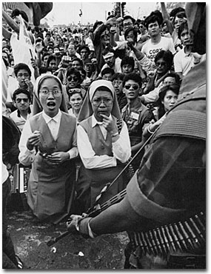
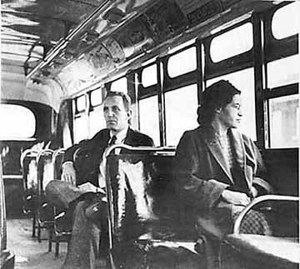
Historical examples
Gandhi as nonthreatening
Rosa Parks as dignified
Filipina nuns as spiritual
Notes:
The many historical examples can contribute to our neo-Gramscian creation of collective myth. Gandhi was, in actuality, quite a threat. Rosa Parks was dignified but the single mother who volunteered as a defendant before her was declined by the NAACP because she would tend to feed a divisive myth that Parks instead helped create. The Filipina nuns were acting as the face of a movement that needed to distance itself from the armed insurrection. Anishinabe treaty rights activists were stoic and unflappable in the face of shrill, threatening Klan-like racial hostility, creating a collective myth that gathered constituences rapidly from a tiny base. Building coalition is far more possible using these sub altern collective myths that rely upon image creation and defense.
Gandhi as nonthreatening
Rosa Parks as dignified
Filipina nuns as spiritual
Anishinabe as dignfied and disciplined in the face of race baiting
Vaclav Havel as gentle playwright

Slide 5
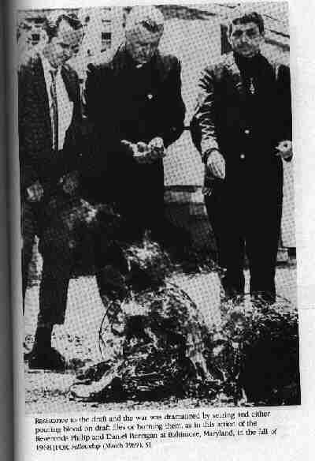
Moral leadership
Archbishop Desmond Tutu
Aung San Suu Kyi
Dalai Lama
Sr. Anne Montgomery
Martin Luther King, Jr.
Berrigan brothers
Filipina nuns
Notes:
The benefits of moral leadership that is not exclusive are many. A clear danger lies in moral leadership that cannot transcend religious roots or that cannot portray itself as pacifist. The advantage of this sort of moral rearmament is that the image of a movement growing in power is swiftly transmogrified into existential threat unless the power of the recruiter is absolutely nonviolent and absolutely committed and absolutely inclusive of all faiths and philosophies. Other leadership exemplars can produce chinks in the armor that can be used by regime propagandists to smear a campaign with a threatening and destructive image.

Slide 6
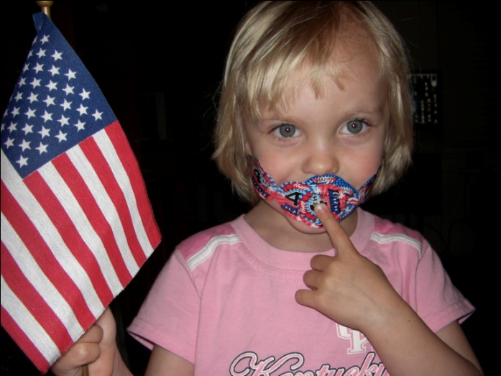
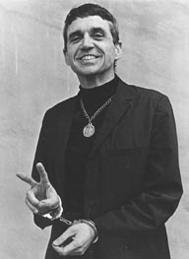
Power of vulnerability
No predator prey evocation
Prompt protective response
Notes:
No predator prey evocation
Prompt protective response
http://hastingsnonviolence.blogspot.com/2011/02/taxonomic-challenges-of-struggle.html

Slide 7
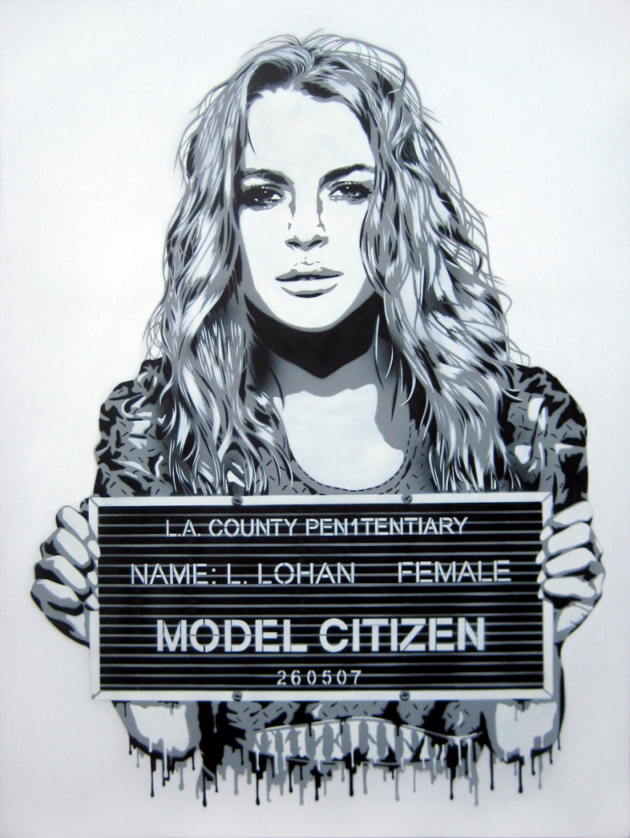
Celebrity: + & -
Association with celebrity can raise profile of campaign
Care to avoid celebrity spokes-role

Slide 8
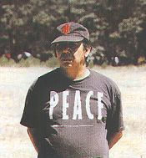
Rebranding with disarming gentleness
Child-friendly
Parent-friendly
Family-friendly
Warrior culture image transformed
Notes:
While there seems to be a fear of creating an image of softness, weakness and passivity, it is far more adaptive to couple a potent civil society movement to an image of non-threatening willingness to dialog. Deepen the invitation and heighten the confrontation. In any struggle the party who hangs back can be ignored and the party who crosses the thin bright line into aggression can be legitimately crushed by all means. Only the party who remains assertively at that line is dealt with as a legitimate opponent. This is the opposite of naiveté. This is full recognition of tyranny and evil and the ongoing nature of conflict.
http://hastingsnonviolence.blogspot.com/2010/12/nonviolence-in-defense-of-sacred-tree.html
http://hastingsnonviolence.blogspot.com/2010/10/whitefeather-walter-whale-rider-and.html
http://hastingsnonviolence.blogspot.com/2010/10/invading-occupying-displacing.html

Slide 9
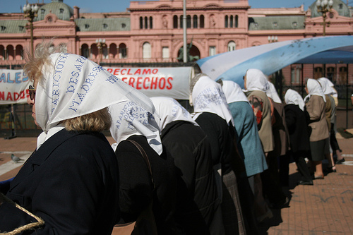
Unprotected become protected
Mothers of the Disappeared
Mothers of the Plaza del Mayo
Women in Black

Slide 10
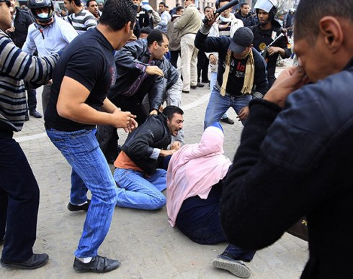
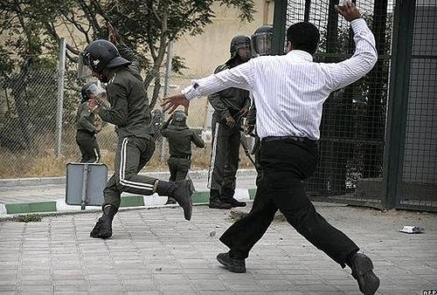
Effects of violence
Repressive violence backfires
Civil society violence backfires

Slide 11
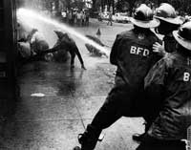
Repressive violence backfires
Innocent image elicits sympathy
Sympathy produces response
Widespread outrage
Notes:
Innocent image elicits sympathy
Seeing children or any other vulnerable people attacked elicits a sympathetic response. When women were force fed in prison during the struggle for suffrage in the US, public officials, men who had been opposed to the vote for women, expressed outrage and even switched positions. When children were abused by Birmingham police and fire personnel in the Children’s Crusade in 1963, even President Kennedy remarked on that.
Sympathy produces response
Women got the vote faster in the US than in Britain, where the women had been using more noisy, quasi violent, methods. The Birmingham campaigns resulted in the Civil Rights Act of 1964 in the US.
Widespread outrage

Slide 12
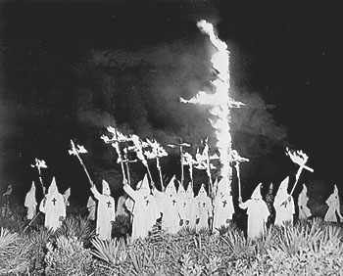
Repressive violence backfires 2
Apathy overcome: unites opposition
Pressure on policymakers
Notes:
Apathy overcome: unites opposition
When two violent sides are in conflict, other parties who are not stakeholders tend to remain uninvolved, apparently with the position that they have no stake in that fight and do not wish to be drawn into it. When one side has an image of absolute nonviolence, that seeming apathy can dissolve and other parties will engage. Even parties with a stake in the struggle will often remain on the sidelines unless one side develops a nonviolent image and the other side uses brutal repression, at which point many more coalitions can be built with a common moral outrage driving the coalition. One example of this is the use of images of children victims of landmines used widely during the ICBL campaign, resulting in the first international law created entirely from civil society, featuring the largest coalition of NGOs ever.
Pressure on policymakers
Even when policymakers continue policies that engender civil society opposition, the results of their repressive violence upon nonviolent challengers with an innocent image produces pressure on them to either reform policy or tone down methods of repression. They realize they begin to look like gangsters to the world and their fig leaves of legitimacy no longer work. All they have left is authoritarianism, without authority.

Slide 13
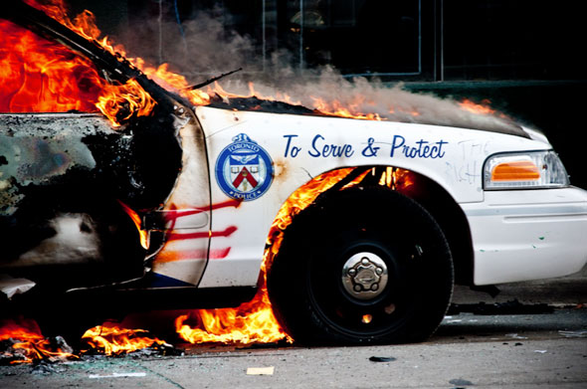
Civil society violence backfires
Alienating
Frightening
Lowers participation
Refocuses from issue
Notes:
Alienating
Seeing civil society doing some version of ‘Day of Rage’ is simply a turn-off. We have all seen enough rage. People are sick of it.
Frightening
Watching members of civil society engage in counter-violence makes other possible participants afraid at several levels. One, will I or a loved one be caught on the street sometime in this violence? Two, if I’ve been at all active in speaking out, even in small ways, will I now be a target? Is this violence coming my way or toward my loved ones?
Lowers participation
Fear and alienation will lower participation. This is negative recruitment and tends to dissolve coalitions rather than unite them, further eroding the power of civil society challengers.
Refocuses from issue
The original grievance is frequently lost or set aside when any violence is used. The focus becomes the violent ones. If it bleeds it leads, and drama will almost always gain more attention, whether it is violent or nonviolent. Suddenly, instead of loss of collective bargaining rights, the issue is the violence from the union and the violent response, justified in the name of law and order. Many more undecided members of civil society, especially in societies where the majority do not have a self-perception of being stakeholders, become grateful for the ‘thin blue line’ that movement violence has now legitimated as the protectors of law and order. Stability becomes the issue, rather than the original grievance.

Slide 14
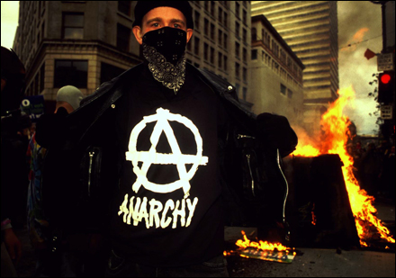
Stop the movement cold
Faceless nihilist imagery
Unknown origins
“More radical than thou” repels
Notes:
Faceless nihilist imagery
In Portland, when I challenged the black bloc to organize their own event rather that impinge on ours, we had 40,000; they mustered 300. There were many characterizations of them as nihilist ‘spoiled brats,’ privileged and unappealing. I lived in a commune with some of their leadership then and they complained endlessly of trivial police behavior and were fixated on rejecting any attempts to get them to think strategically, obsessing with tactics instead.
Unknown origins
Masks add to general distrust of highly kinetic and unpredictable flash mobs of self styled anarchists. It was impossible to assess accountability and determine who were police agents.
“More radical than thou” repels
Faith based activists were happy to come to the streets for ‘family friendly’ demonstrations but not when roving bands of masked black bloc anarchists provoked police and destroyed property, even as they taunted members of churches and labor unions for being mere liberals and not radical enough.

Slide 15
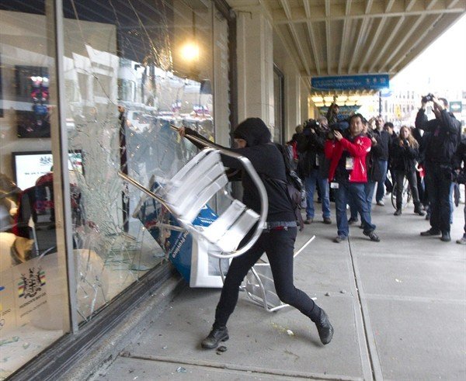
Image destruction
Recruitment diminishes
Issue redirection
Policymakers can safely ignore
Notes:
http://hastingsnonviolence.blogspot.com/2010/11/christmas-tree-bomber-and-sacred.html
http://hastingsnonviolence.blogspot.com/2010/11/taking-it-to-streets.html
Turns out Oscar Wilde was wrong about at least one thing when he claimed “There is no such thing as bad publicity.”

Slide 16
Attacking image
Agents provocateurs
Radical flank
Notes:
Agents provocateurs: Black Panthers, Honeywell Project, Earth First!, Nation of Islam, etc.
See Schock’s webinar:
http://www.nonviolent-conflict.org/index.php/learning-and-resources/educational-initiatives/usip-course/icncusip-2010/1428-radical-flank-effect-webinar

Slide 17
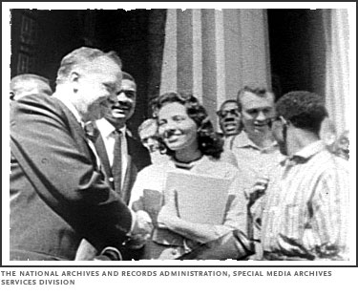
How image is created and managed
Construct image of power
Superhuman nonviolence
Enabling image enhancement
Legacy sensitivity
Don’t give peace a chants
Proactive semiotics
Credibility
Notes:
http://hastingsnonviolence.blogspot.com/2011/01/tossing-wide-net.html

Slide 18
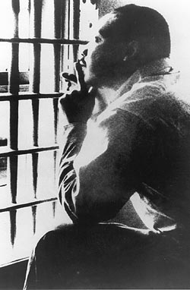
Construct image of power
Letter from Birmingham Jail
South African boycott leaders
Danish Freedom Councils
Notes:
Martin Luther King wrote in his Letter from Birmingham Jail that the purpose of direct action is to get to the negotiating table. If we seem to show we are unwilling to negotiate, we have shifted into the mode of straight power-over and we need the committed high numbers of participants prepared to essentially go on general strike if we intend to topple a ruler or end an occupation or transform a system without discussion. In his 1979 essay on ending war, Gene Sharp wrote that “negotiations are no substitute for the capacity to struggle and apply sanctions.” The problem with some who hold that position is that, unlike Sharp and MLK, they fail to understand that generating civil society power through mass recruitment and an image of sustainable sanction is how civil society gains the status to get to the negotiations and ultimately to authoritatively generate options for satisfactory resolution. Thus, as in the South African boycott case, an image of power is associated with those who are imprisoned and labeled terrorists, even though they have neither committed nor threatened violence, and those leaders are suddenly released and invited to negotiate, commensurate with their image.

Slide 19
Superhuman nonviolence
Imagery of courage
Rising above the norm
Shocking forgiveness
Notes:
While the Che Guevara triggering theory of revolutionary violence is largely discredited, the nonviolent analog is interesting. Occasions of repressive violence met with astonishing acts of forgiveness, for example, can trigger a shift away from violence toward dialog. This, in addition to unprecedented maintenance of nonviolent discipline in the face of violent repression, can help repair images of a movement. Arguably, for example, the combination of the Gazan doctor’s refusal to hate Israelis even after they slaughtered his daughters, combined with the nonviolent discipline maintained fairly well in the Budrus struggle, helped recreate or repair the image of Palestinian resistance.
http://hastingsnonviolence.blogspot.com/2011/01/forgiving-unforgivable.html

Slide 20
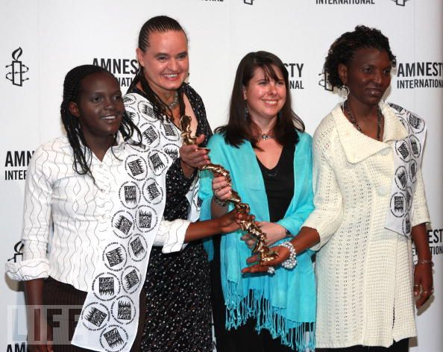
Enabling image enhancement
WOZA
Aung San Suu Kyi
Desmond Tutu
Martin Luther King, Jr.
Notes:
Externals can enhance the image of the civil society organizations waging nonviolent conflict against violent repression. Amnesty International awards, Nobel Peace Prizes, and general commentary can be created and used to keep up pressure on policymakers and afford some protection to leadership.

Slide 21
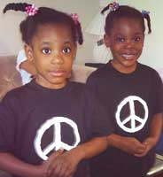
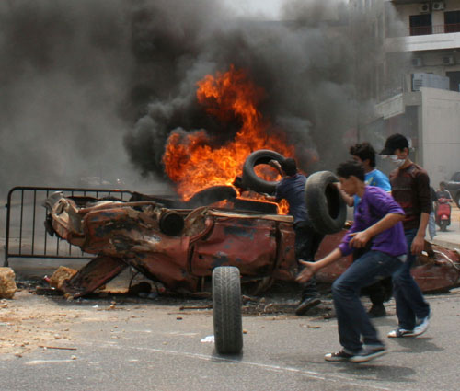
Legacy sensitivity
Capitalize on movement identity
Avoid negative triggers
Transform negative legacy components
Combine best elements of legacies to form new movement identity
Notes:
References
Schiwy, F. (2009). Digital ghosts, global capitalism and social change. Social Identities, 15(3), 313-330. doi:10.1080/13504630902899051
Photo: http://www.flickr.com/photos/carolekerbage/2474212080/

Slide 22
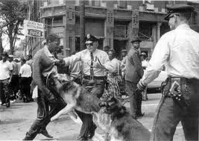
Legacy sensitivity 2
Expropriate positives
Feature negative legacy of oppressor
Do not overplay
Notes:
Expropriate positives
What are the positive images your movement, or its predecessors, have generated? Evoke them if they can legitimately associate your current movement with admirable traits such as innocence and friendliness—as well as victory.
Feature negative legacy of oppressor
What poor practices or brutal oppression has your oppressor used in the past? Are there associations to current leadership or statements or policies?
http://hastingsnonviolence.blogspot.com/2011/01/how-many-children-will-it-take.html
http://hastingsnonviolence.blogspot.com/2010/12/revenge-slippery-slope-to-hell.html
Do not overplay
Steady complaints about your oppressor without a concomitant image of movement accountability may introduce compassion fatigue. Show alternatives that look good to many constituencies.

Slide 23
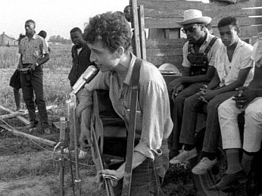
Don’t give peace a chants
Silent or singing invites more
Wall of angry sound alienates
Willingness to dialog

Slide 24
Proactive semiotics
Logo
Body language
Slogans
Notes:
Your logo is a cultural claim. It produces a high context over time, transmitting volumes. It is far harder to misrepresent your image when you have invented and promulgated it.
http://hastingsnonviolence.blogspot.com/2011/01/body-image-and-social-movements.html

Slide 25
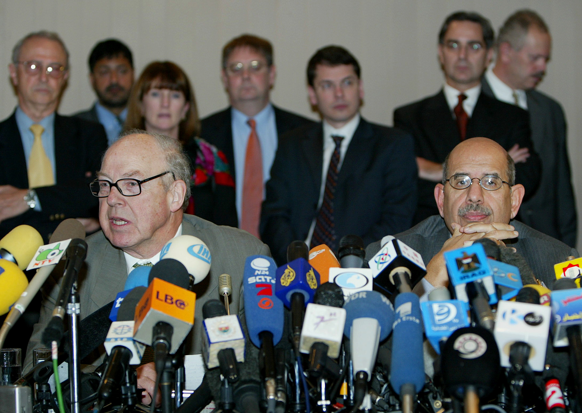
Credibility
Consistency
Validity
Persistent
Seeking dialog
Evidence-based
Notes:
ELF trial

Slide 26
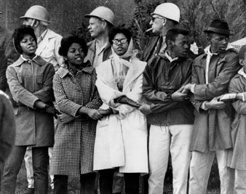
Contrasting images
Big armed agents of repression
Vulnerable civil society
Deepen contrast

Slide 27
Defending image
Liaisons to police and armed forces
Liaisons to all media
Consensed upon code of conduct
Peace monitors
Notes:
All these elments are used to develop inoculants against spoilers/agents provocateurs
Liaisons to police and armed forces
From Otpur to Egypt and domestically in Portland, Oregon, liaisons can prevent tragedies and help stop the descent into violence. They can reassure armed agents of the state that, as long as they hang back and do not attack peaceful protesters, they themselves are not the issue. My own experience with this, for almost 30 years, is that it is always advisable.
Liaisons to all media
Any movement needs a media team to create and improve and defend its image, an image that is increasingly important and contextualized by encouraging peace journalism through gentle personalism.
Consensed upon code of conduct
When organizers can discuss and eventually agree on a code of conduct expected by all individuals in a movement, that written agreement needs to be part of all liaison packets, to police, armed forces, and all media. It is the kind of image creation and defense that can make the crucial difference when enormous pressure otherwise creates violent backlashes. It can make the cynical use of agents provocateurs far less easy, or even impossible, and it makes journalists and eventually the public far less credulous about regime lies. The change in recruitment can be dramatic when this code is known widely.
Peace monitors
Using skilled, trained peace monitors to help keep everyone on message and operating in resonance with a code of behavior is key. Many monitors make the events, the demonstrations, the challenges and the nonviolent resistance far less likely to result in bloodshed and far less vulnerable to misinterpretation by police and media. These people need de escalation skills and commitment and discipline. Small, short handouts help, explaining the organizers from many groups all agree, this is our code of behavior. Those who cannot commit to these practices should leave and not under any circumstances portray themselves as a part of the larger movement. The movement will care for them but if they violate this code, the movement reserves the right to denounce that behavior. These measures act as inoculants against the inevitable spoilers or agents provocateurs.

Slide 28
Defending image 2
Context (press packets, outreach)
Education (introduce and buttress alternatives)
Informational sessions
Notes:
http://hastingsnonviolence.blogspot.com/2011/01/misquoting-and-misunderstanding-king.html

Slide 29
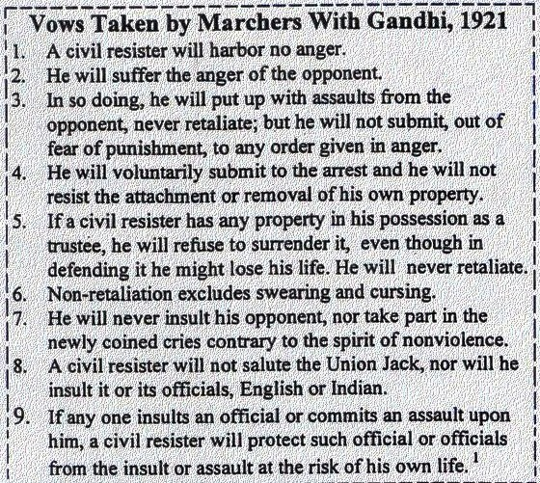
Media and image
Understanding war and peace journalism
Strategies
Numbers and access
Social media
Mainstream media
Advocacy media

Slide 30
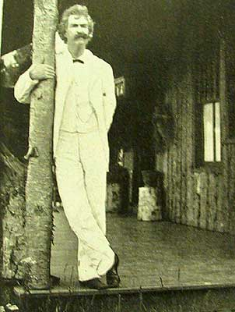
Media as misinformant
A man who does not read a newspaper is uninformed. A man who does is misinformed.
—Mark Twain

Slide 31
Table 1: War and peace journalism characteristics. Sources: Galtung (1986); Lynch & McGoldrick (2005a); Lee, Maslog & Kim (2006).
Characteristic | War journalism | Peace Journalism
Dichotomizing (moral judgment toward one side) | x
Dichotomizing solutions (a or b) | x
Assigning blame (who started it) | x
Here and now (devoid of historical context) | x
Elite orientation | x
Emotive language | x
Multiparty orientation |  | x
Nonpartisanship |  | x
Avoidance of emotive language |  | x
Historical contextual balance |  | x
Exploration of range of options |  | x
Notes:
Table 1: War and peace journalism characteristics. Sources: Galtung (1986); Lynch & McGoldrick (2005a); Lee, Maslog & Kim (2006).
Media/Peace Journalism
In her meeting with Saddam just before the war, Ambassador April Glaspie had also pointed out to the Iraqi leader that “if the American president had control of the media, his job would be much better.” The war gave Bush an excuse to exercise such control. He and Saddam were in total agreement on the subject of censorship, and the press, for the most part, trailed along like proper spaniels (Ridgeway, 1991, p. 238).
This section describes the literature that goes to the ideas of media types, relationship to war and peace, and the availability of media types to counternarratives. Galtung (2002b) and Freire (2000) both challenge intellectuals to engage in liberating civil society. Lynch and McGoldrick (2005a) want the field of journalism to meet those intellectuals halfway, asserting that, “If journalism is to be reliable, accurate and useful, therefore, it has to join the long list of endeavors to develop a critical self-awareness” (p. xvi).
Mainstream media can be a driver to war or peace, reporters and editors even taking on the role of mediator to attempt to achieve peace, as did John Scali in 1962 during the Cuban missile crisis, Walter Cronkite in 1977 between Sadat and Begin, Patrick Seale in 2000 to break Syria-Israel deadlock, and Anna Politkovskaya in 2002, as she attempted to help facilitate and mediate between Russia and Chechens in the Moscow Theater hostage crisis (Gilboa, 2009, p. 463). Some scholars assert there is no more vital consideration than media to those who wish to promote war or peace (Cortright, 2006; Herman & Chomsky, 1988; Lynch, 2008). Hammond (2000) wonders what to make of the U.S. mainstream media focusing repeatedly in late 2002 and early 2003 on Saddam Hussein’s 1988 attacks on Kurds after that same media had ignored, misreported and minimized that news when it happened. “Consensus in Washington means criticism is marginalized in the media” (p. 849). This problem of ‘politics stops at the water’s edge’—that is, foreign policy is bipartisan—is not merely a political problem; it is echoed in the media, which then make “no independent contribution” (Mermin, 1999, p. 143). While this may be accurate in the U.S. mainstream media, it is also evident in media from elsewhere. So, for example, Mass Communications scholars Seow Ting, Crispin C. Maslog and Hun Shik Kim (2006) studied 1,558 stories on the Iraq War and various Asian conflicts in eight English-language Asian dailies and found that the unpopular U.S. invasion of Iraq used peace journalism frames originally conceived of by Johan Galtung (1986), but that more local conflicts (shooting wars over Kashmir, Sri Lanka, the Philippines and Indonesia) used war journalism framing. War journalism may tend toward inaccuracy as it favors dichotomizing language along with a lack of historical perspective outside elite interests or skewed assignment of blame (Lynch, 2008; Lynch & McGoldrick, 2005a). Majid Tehranian (2002) concurs and claims peace journalism is simply good ethical journalism. Following Galtung (1986), Table 2 summarizes the characteristics of war journalism and peace journalism.
Is mainstream media accurate? Does it lead to an informed electorate? “Mark Twain said, ‘a man who does not read a newspaper is uninformed. A man who does is misinformed’” (Lynch & McGoldrick, 2005b). Consuming media is often a recipe for becoming increasingly ill-informed rather than more informed about many conflicts (Herman & Chomsky, 1988; Schechter, 1999). This is especially true if mass media parrots administration claims rather than engaging in investigative journalism, as we learned with the Bush administration falsehoods about weapons of mass destruction used to justify the invasion of Iraq (Warrick, 2006).
People will often believe the sources that seem to propose the course of action or policy that will satisfy their needs as posited by Maslow’s hierarchy most accurately (Treadwell & Treadwell, 2005). If the only credible promise to secure basic physiological or safety needs comes from a call to arms, that call will be most persuasive. If all credible alternatives are kept out of mainstream media, war can appear to be the only reasonable option. Since mainstream media ownership is becoming more concentrated in fewer corporate owners (six now dominate mainstream media), the appearance of consensus can be manufactured (Croteau & Hoynes, 2003; Herman & Chomsky, 1988). This is made even easier in the U.S. by a confluence of two more factors. One is increasing ability to niche market to particular demographic sectors and the other is that “86 percent of adults get news from television ‘frequently’ (at least a few times a week), while only 7.6 percent never use television as a news source” (Corporation for National and Community Service, 2010, p. 6).
There are patterns of official rationales for war, often parroted by mainstream media, that indicate war propaganda, and propaganda is not limited to media conduct during war; it can create a political climate that will permit an otherwise unwanted war (Carruthers, 2000; Gan, 2005; Herman & Chomsky, 1988; Seib, 2004). This is illegal. “War propaganda is prohibited by Article 20 of the UN’s International Covenant on Civil and Political Rights (ICCPR), ratified by over 150 countries” (Harrop, 2004, p. 311). The received wisdom from this war propaganda not only tends to make citizens support war but to also regard critics of the war as naive at best and often as traitors who side with an evil enemy. Indeed, the propaganda has a self-fueling capacity in many cases not only toward war but toward all the normal concomitants of war, e.g., loss of civil liberties for citizens and non-citizens alike. During war, the presumption of innocence can transmogrify into presumption of guilt, as we saw with those locked up at Guantanamo, Abu Ghraib and elsewhere, the vast majority of whom never had a trial; George W. Bush labeled them ‘bad people’ and ‘evil doers’ with virtually no challenge from mainstream American media for several years. In other nations—even in the largest U.S. ally country, Britain—media reaction was much less monolithic, much more partisan or left-right (Tumber & Palmer, 2004). In the U.S., mainstream media only varied in how vigorously they agreed that Iraq should be invaded, especially following Colin Powell’s UN speech (McChesney, 2004). And mainstream media only became truly interested in any level of challenge to the Executive branch falsehoods about WMD or al-Qa’ida connections to Saddam Hussein after the George Bush Top Gun flight to an aircraft carrier to declare that the Iraq mission was accomplished, to announce “the end of major hostilities” (Seib, 2004, p. 139). Parsing out culpability for this massive failure is delicate and necessary.
What accretion of “evidence” can finally lead to an acceptance by the American citizenry of war? From Lynch and McGoldrick (2005a):
Six ‘screens’ that need to be passed before the public will condone the US use of force:
rogue leaders
evidence tying them to heinous crimes
non-military means exhausted
military allies (to share the risk and cost)
a visionary objective (e.g. turn an enemy into an ally or bring long-term peace to a region)
early non-military intervention (p. 97).
Constructing rationales to help bring the drumbeat for war through all these filters is not easy and leaves a trail. The Pentagon, elected officials, and challenger groups will naturally contest control of the discourse and the frames in any consideration of war or the threat of war. The Pentagon devotes enormous resources to this and its history and evolution of methods of dominating the discourse are complex (Hess & Kalb, 2003). Methods have included censorship, hostility to independent media, planted stories by secretly paid journalists, information control, disinformation (lies) dissemination, access bias, press pooling, embedded reporters and other means (Jamieson, & Waldman, 2003; Stauber, & Rampton, 1995). The military is constantly evolving and learning how to manage public perception, hiring experts to analyze and evaluate, such as the 2004 Rand report, Reporters on the battlefield: The embedded press system in historical context (Paul & Kim). While the authors are positive about the benefits of the embed system to the military and public perception, they warn that the discourse about objectivity cannot be easily dismissed, and indeed liken the fawning reportage that embeds frequently produce to the so-called ‘Stockholm Syndrome’, in which the hostages fall in love with their captors and parrot their message (p. 112). Reporters who accept protection from a military will rarely adopt a neutral, critical, or oppositional viewpoint about the war or the military in question (Thussu & Freedman, 2003). Indeed, if they do, they will likely find themselves ejected from the embed system (Tyson, 2009).
Part of the problem is the social psychology of the U.S. culture’s relationship to war and war mythology, generated in part by the nation’s identity enshrined in both the American Revolution and World War II, making all wars in which the U.S. fights an extension of those wars at a visceral level, and all U.S. members of the armed forces nearly holy warrior patriots, motivated by altruism and a rugged individual resolve to defeat evil. This is reflected, in part, in war stories, treated journalistically from an embedded and uncritical stance, as opposed to the kind of ethical objective journalism required to elicit the stories of war that can reveal how hurtful it really is.
William B. Brown is a Sociologist at Western Oregon University who studies the power of personal stories in the context of his discipline. Noting the war-promoting tendency of some stories and the peace-promoting aspects of others, he writes, “For me, war stories are born of arrogance, and they reek of insolence. Stories about war are another matter. They demand reflection on the past and offer an insight into the insanity of war” (2005, p. 245). When Brown and the thousands of others teach, they provide a countervailing perspective in the war system; can his peace perspective be more widely disseminated, along with the peace perspectives of the other thousands who bring their scholarship into the classrooms and academic journals? Indeed, asserts Media professor W. James Potter, in a society with basic free speech, the strongest social norm force for change away from a culture of violence is education undertaken in the classroom and in the home (Potter, 2003). Teaching children media literacy is complex and asks much of the teachers, yet failing to instruct in the hermeneutics of the media and methods of conflict management will allow those who profit politically or financially from destructive conflict to continue to flourish (Semali & Pailliotet, 1999). Related is the media literacy that helps students learn to recognize racism, sexism and other bias in media (Wilson, Gutiérrez, & Chao, 2003). Objectifying any identity group is a normal precursor to violence and is thus crucial to reveal and challenge.
When powerful politicians wish to be elected, they often promise peace and cast their opponents as dangerous hawks—even though those very politicians, once elected, often vote for war. This was the sequence for Woodrow Wilson, Lyndon Johnson, Richard Nixon and other American politicians. Indeed, the famous 1964 ‘daisy ad’ produced by the Johnson campaign showed a little girl pulling petals from a daisy while an ominous voice counted down, then rockets launched, then mushroom clouds depicting nuclear war, and finishing with reassurance from Lyndon Johnson. That ad helped defeat Barry Goldwater (Cortright, 2006, p. 201); peace promotion can work in the democracy in the popular media (even though Johnson massively escalated the war in Vietnam he declined the advice of those in his administration who advised using nuclear weapons, apparently believing the American people would not forgive that, probably because Vietnamese forces hardly threatened U.S. soil).
The history of access to media is long and is evolving more rapidly than ever. Propaganda and public opinion persuasion grew in the era of Martin Luther, with the invention of the printing press (Jowett & O’Donnell, 2006), more instantly in the era of Martin Luther King, Jr., with the availability of television, and is evolving into a more democratic but chaotic picture with Internet, phone-texting and other cutting-edge mass technologies. Peace and justice by peaceable means requires media for success and there are several strategies available to public peace scholars who wish to help; indeed, this improvement in technology has caused public peace scholar Johan Galtung (2002b) to change his mind toward optimism that peace educators can reclaim enough public discourse to make a difference. Traditionally, an individual professor may compose a guest editorial and seek distribution in a newspaper, with chances of success diminishing as a result of a variety of factors, including quality of writing, status of the author, and distance from the publication. Nowadays, with blogs and many websites devoted to niche constituencies, access is immediate and occasionally available to large numbers of mainstream consuming public. Jennings & Zeitner (2003) did quasi-experimental longitudinal work, on members of the “Baby Boomer” generation, which shows a modest increase in what they call civic engagement amongst those who use the Internet compared to those who do not. Even a modest increase in civic engagement can, in turn, affect civil society awareness and struggles. The effects can be remarkable, even in oppressive societies, though such regimes have now learned to keep pace. In Serbia in elections in 1996 the student-led challenger movement to Milosevic control over local elections used fax and email far more efficiently than did the regime. Indeed, recalls one pro-democracy student leader, “During the student protests our web page was popular, and the police broke in and said, ‘Where is that Internet?’ as if they could confiscate it” (Ackerman & DuVall, 2000, p. 479). Now, however, pro-democracy dissidents in Iran need to race to find technological paths to communicate that the government has not monitored, blocked, or otherwise bottled up and damped. In many ways, peace and justice organizations and oppressors co-evolve both technologically and in persuasive messaging, almost like an arms race toward war or peace, justice or injustice.
Mainstream media not only usually reaches more people per source than does alternative media, it serves as the traditional driver for war propaganda issued by the state (Jowett & O’Donnell, 2006). Unsurprisingly, then, research shows that “All other things being equal, the news media generally play a negative role in attempts to bring peace” (Wolfsfeld, 2004, p. 220). The battle for hearts and critically thinking minds is thus an asymmetric struggle, yet not one that can be surrendered—small opportunities can and ought to be exploited (Ryan, 1991). Regarding owners, publishers, CEOs, editors and reporters of mainstream media as the enemy is both unprofitable and is outside the basic peace approach pioneered by Gandhi, who clearly acted as though everyone, including the most strenuous opponent, is a potential ally (Juergensmeyer, 2005). These approaches demonstrate the conflict management models peace and justice professors promote and ideally practice.
Media studies show the ongoing struggle between the competing forces of localism and concentration, that is, between the smaller audience locally owned media and the large audience large corporate concentrated media (Potter, 2005). This works to the advantage of local peace professors as they attempt to bring a peace analysis to local media on the one hand, and against them when the more organized and more monolithic war promoting stance of concentrated corporate media is encountered. While the acquisition of horizontal and vertical media by single owners or corporations is a slow process favoring profitability over message control (Goldenson & Wolf, 1991), the eventual effect is toward a particular bias if an owner is ideological (e.g. Rupert Murdoch) or if corporate ties between media and war profiting enterprises become too great. The likelihood of peace messaging then seems to decrease.
As both noted and predicted in pre-Internet, pre-Twitter 1967 by Marshall McLuhan and Quentin Fiore, the nature of the media is evolving so quickly that all conflict becomes much more known in the global village. Niche marketing news and views is much more possible with the individual profiles computerized more and more centrally, so that the struggle for peace or war is multi-fronts and multi-level.
The U.S. government has now begun annual civic engagement measuring with its first such broad survey and results, showing that, by the federal government’s exceedingly broad definition, almost all Americans are engaged in civic engagement, and that Internet access boosted this (Corporation for National and Community Service, p. 1: http://civic.serve.gov/issuebrief.cfm

Slide 32
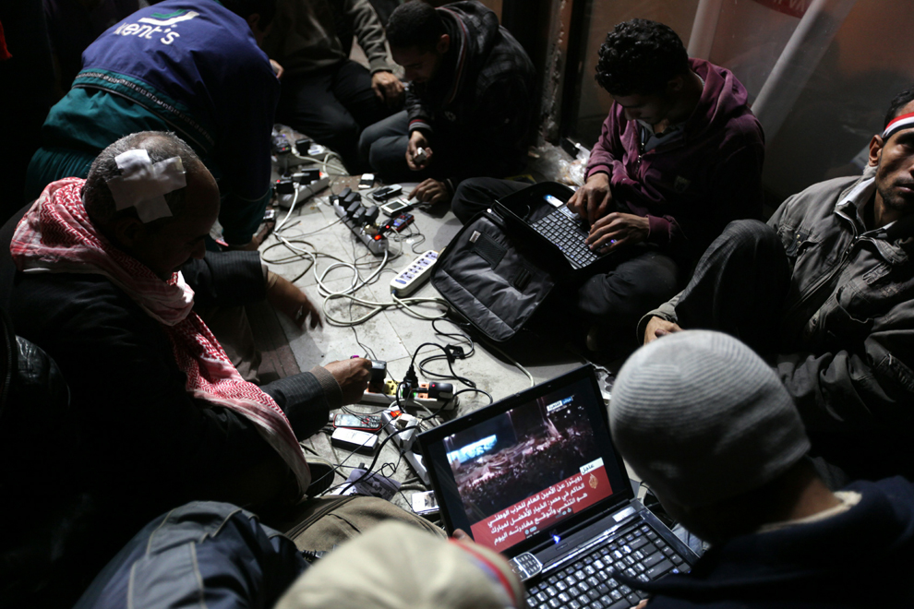
Media strategies
Social media
Mainstream media
Alternative media
Notes:
Media kills or cures: Promoting nonviolence
In the late 1970s I was involved in a movement to shut down a nuclear weapons command facility. We generated little notice and a few recruits (pictured).
Just a few years later, Randall Forsberg (pictured) started the nuclear freeze movement and brought a million people to a peacewalk in New York. We realized we had not been learning how to use media to recruit.
You are in a movement. You have realized that you need to recruit more numbers to your ranks. You need to create political pressure to get the policy change you seek. In short, you need media.
The dream: Major media takes the content of your brochures, your position papers, your manifesto, and puts it on page one. Since you are not the Unabomber, you don't take that fantasy too seriously. Instead, you begin to think about media strategies and tactics to operate as nonviolent civil resistance strategies and tactics.
Media gets you public attention, relevance, significance, and some possible protection. So how do you message to get the best help from the media? Your message is fact, perspective and transmits your connection to others as well as your credentials to offer a credible message.
There is no faster way to engage in leveling the playing field than to use media.
These are easy principles and they all swiftly degenerate into lots of hard work.
Failing to control the message will fail to recruit support and participation.
Messages are authentic and simple. They resonate with shared values. Use the values base to draw others to your approach. The more elements and the more confusing the long list of positional demands in your message, the more your recruitments cancel each other out.
Ride the policy wave. Be a player in the dialectic. Your timing is crucial. Like a surfer, you watch the building waves behind you and you learn when to switch to high energy and all the muscle you can bring to bear.
Control your image. Rachel Corrie's image justified her death. Nicolas Kristof specifically features the suffering of young girls in order to gain more resources and justice for everyone, because research into public opinion shows that sympathy for young girls outranks sympathy for all others. When someone turns on a television to see members of an antiwar demonstration burning soldiers in effigy your message for that demonstration will negatively affect recruitment. You may gain 11 burn-it-down nihilists and lose 1,100 working citizens. Think in terms of net gain.
A great part of your people power should be devoted to media. The older I get and the more campaigns I work in, the more I'm convinced that our work should be one part action, four parts discussion and negotiation, and five parts media. Whatever the ratio or priorities of your group, move media up high and get the people power to make it happen.
Gentle personalism. There is no substitute for relationship advantage. Don't let the default arrangement be the unchanging status quo. If an editor isn't your friend, make her your friend. If a reporter doesn't know who you are, invite him out for coffee, have a couple of things in writing, but don't give him those things until you are shaking hands goodbye for the day. This apparently unfair and biased approach is simple human nature. It works and ignore it to the detriment of your campaign, your movement, and your personal cache as a news provider.
Grab 'em by the throat in the first few seconds and never let go. National Public Radio aired a segment that included an interview with a long-retired movie director who was asked how he got the interest of the viewers. "I grab 'em by the throat in the first few seconds and never let go," was the response. Make your pitch, your press release, and your own writings center on stories that illustrate your point. Start with the story, make your point, mention the story again, and you are happily helping the mainstream media operative to help you.
In our little case to shut down a nuclear weapons command site we did learn how to use the media eventually. We generated stories in many local, state, and regional media, and even into national media such as the Christian Science Monitor and surprisingly even one long story in Asahi Shimbun, a huge Japanese newspaper. Despite the US navy telling us that they would keep the facility open for another 30-35 years, it's shut down now. I think we did a good job, finally. It's never too late to learn.
Posted by Tom H. Hastings at 6:32 AM Email This BlogThis! Share to Twitter Share to Facebook Share to Google Buzz
Labels: media, media skills, promoting nonviolence, Randall Forsberg

Slide 33
Table 2: Media typologies. Select media, availability or access , and the general size of the consuming public for each type of media.
Media type | access | Size of consuming public
Mainstream newspapers | moderate | variable small to large
Alternative newspapers | high | small
Mainstream magazines | low to moderate | variable moderate to large
Alternative magazines | high | small
Mainstream radio | low | moderate to large
Alternative radio | high | small
Network television | low | large
Cable television | high | small
Internet | high | large

Slide 34
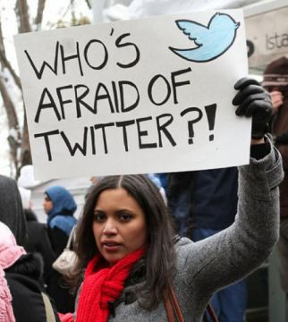
Social media
“I took a day off of Facebook and missed the revolution!”
Repressive regimes made sick by texting and there is no Tweetment!
Notes:
References
Massicotte, M. (2009). Transborder Activism in the Americas: Exploring Ways to Better Assess and Learn from Less Powerful Forces, Towards Other Possible Worlds. Globalizations, 6(4), 411-431. doi:10.1080/14747730903298595
counter-hegemonic bloc of social forces (p. 413)

Slide 35
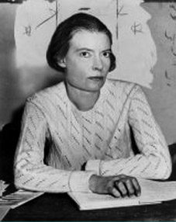
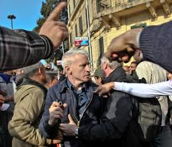
Mainstream media
Gentle personalism
Transparency
Accountability
Interest and educate

Slide 36
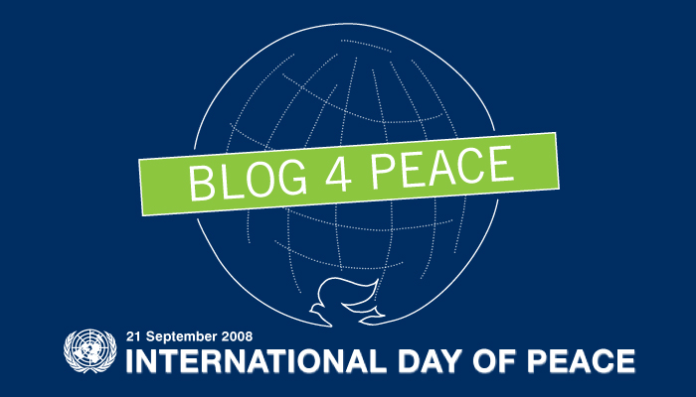
Advocacy media
Educate those with value affinity
Activate the interested
Notes:
References
Ackerman, P., & DuVall, J. (2000). A force more powerful: A century of nonviolent conflict. New York: St. Martin’s Press.
Audit Bureau of Circulations (2009). U.S. newspaper circulation averages for the six months ended: 3/31/2009. http://abcas3.accessabc.com/ecirc/newstitlesearchus.asp, retrieved September 26, 2009.
Aufderheide, P. (1990). Good soldiers. In M. C. Miller (Ed.). Seeing through the movies (pp. 80-111). New York: Pantheon Books.
Barash, D. P. (Ed.) (2010). Approaches to peace: A reader in Peace Studies (2nd ed.). New York: Oxford University Press.
Bercovitch, J.; Kremenyuk, V.; & Zartman, I. W. (Eds.) (2009). The Sage handbook of conflict. Thousand Oaks, CA: Sage.
Boulding, E. (2000). Cultures of peace: The hidden side of history. Syracuse, NY: Syracuse University Press.
Boyer, W. H. (2002). Education for the Twenty-First century. San Francisco: Caddo Gap Press.
Brownstein, R. (1990). The power and the glitter: The Hollywood-Washington connection. New York: Pantheon Books.
Carruthers, S. L. (2000). The media at war. New York: St. Martin’s Press.
Castaneda, R. (September 20, 2010). Civil rights activist Ronald W. Walters remembered as 'understated, but an overachiever.' Washington Post, B01. http://www.washingtonpost.com/
Chomsky, N. & Barsamian, D. (2001). Propaganda and the public mind. Cambridge, MA: South End Press.
Clurman, R. M. (1992). To the end of Time: The seduction and conquest of a media empire. New York: Simon & Schuster.
Cohen, A. (2010). Israel's nuclear future: Iran, opacity and the vision of global zero. Palestine - Israel Journal of Politics, Economics & Culture, 16(3), 6-19.
Cohen, J., & Solomon, N. (1995). Through the media looking glass: Decoding bias and blather in the news. Monroe, ME: Common Courage Press.
Conboy, M. (2004). Journalism: A critical history. Thousand Oaks, CA: Sage.
Cortright, D. (2006). Gandhi and beyond: Nonviolence for an age of terrorism. Boulder, CO: Paradigm.
Corvette, B. A. B. (2007), Conflict management: A practical guide to developing negotiation strategies. Upper Saddle River NJ: Pearson Education Inc.
Croteau, D. & Hoynes, W. (2003). Media society: Industries, images, and audiences (3rd ed.) Thousand Oaks, CA: Pine Forge Press.
Dart, J. (2002). Church leaders oppose attack on Iraq. Christian Century, 119(19), 14. Retrieved from Academic Search Complete database.
Dyer, G. (1993) The roots of war. In Ringler, D. (Ed.) Dilemmas of war and peace: A sourcebook. Madison, WI: University of Wisconsin-Extension.
Ehrlich, P. R. (2008). Population, environment, war, and racism: Adventures of a public scholar. Antipode, 40(3) 383-388.
Evans, J. A. (1998). Celluloid mushroom clouds: Hollywood and the atomic bomb. Boulder, CO: Westview Press.
Ewan, S. (25th anniversary ed.) (2001). Captains of consciousness: Advertising and the social roots of the consumer culture. New York: Basic Books.
Filiatreau, J. (2002). GAC calls for U.S. restraint on Iraq. Network News, 22(4), 5. Retrieved from Academic Search Complete database.
Fischer, L. (1963). The life of Mahatma Gandhi. New York: Harper & Row (original 1950).
Fisher, R. & Ury, W. (1991). Getting to yes: Negotiating agreement without giving in. (2nd ed.). New York: Penguin Books.
Fisher, R., Kopelman, E., & Schneider, A. K. (1994). Beyond Machiavelli: Tools for coping with conflict. Cambridge, MA: Harvard University Press.
Fisher, R., & Shapiro, D. (2005). Beyond reason: Using emotions as you negotiate. New York: Penguin Books.
Freire, P. (2000). Pedagogy of the oppressed. New York: The Continuum International Publishing Group.
Fry, D. P. (2006). The human potential for peace: An anthropological challenge to assumptions about war and violence. New York: Oxford University Press.
Galtung, J. (2002a). The role of the intellectual—An excursion into self-criticism. Higher Education in Europe, 27(1/2), 60-63.
Galtung, J. (2002b). The role of the intellectual II—This time as other-criticism. Higher Education in Europe, 27(1/2), 65-68.
Galtung, J. (2005). Pax Pacifica: Terrorism, the Pacific hemisphere, globalisation and Peace Studies. Boulder CO: Paradigm.
Galtung, J. (2006). A Review of: “Media and the Path to Peace”. Political Communication, 23(3), 364-366. Retrieved 10/17/2010 from Academic Search Complete database.
Gan, B. L. (2005). Pressed into war. Peace Review, 17(4).
Gandhi, M. K. (1983). Autobiography: The story of my experiments with truth. New York: Dover Publications, Inc. (original Public Affairs Press, 1948).
Gilboa, E. (2009). Media and conflict resolution. In Bercovitch, Jacob; Kremenyuk, Victor; & Zartman, I. William (Eds.). The Sage handbook of conflict resolution (pp. 455-474). Thousand Oaks, CA: Sage.
Golan, G. & Gal, A. (2009). Globalization and the transformation of conflict. In Kriesberg, L., & B. W. Dayton (Eds.) Conflict transformation and peacebuilding: Moving from violence to sustainable peace. New York: Routledge.
Goldenson, L. H., & Wolf, M. J. (1991). Beating the odds: The untold story behind the rise of ABC. New York: Charles Scribner’s Sons.
Gregor, T. (Ed.) (1996). A natural history of peace. Nashville TN: Vanderbilt University Press.
Hammond, P. (2000). Lessons of the first draft of history. Media, Culture & Society, 22 (6) 847-851.
Harrop, L. (2004). Propaganda's war on human rights. Peace Review, 16(3), 311-316.
Hastings, T. H. (2000). Ecology of war & peace: Counting costs of conflict. Lanham, MD: University Press of America.
Heptonstall, G. (2008). Noam Chomsky on America, peace and war. Contemporary Review, 290(1689), 241-243.
Herman, E. S. & Chomsky, N. (1988). Manufacturing consent: The political economy of the mass media. New York: Pantheon Books.
Hess, S., & Kalb, M. (Eds.) (2003). The media and the war on terrorism. Washington DC: Brookings Institution.
Irani, G. E. (2004). Islamic mediation: Techniques for Middle East conflicts. In F. E. Jandt (Ed.), Intercultural communication: A global reader (pp. 360-376). Thousand Oaks, CA: Sage.
Jamieson, K. H., & Waldman, P. (2003). The press effect: Politicians, journalists, and the stories that shape the political world. New York, NY: Oxford University Press.
Jandt, F. E. (2007). An introduction to intercultural communication: Identities in a global community (5th ed.). Thousand Oaks, CA: Sage Publications.
Jennings, M. K. & Zeitner, V. (2003). Internet use and civic engagement. Public Opinion Quarterly, 67(3), 311-334.
Joffe, J. (2009). The default power. Foreign Affairs, 88(5), 21-35. Retrieved from Academic Search Complete database.
Jowett, G. S. & O’Donnell, V. (2006). Propaganda and persuasion (4th ed.). Thousand Oaks, CA: Sage.
Juergensmeyer, M. (2005). Gandhi’s way: A handbook of conflict resolution. Berkeley, CA: University of California Press (originally Fighting with Gandhi: A step-by-step strategy for resolving everyday conflicts. San Francisco: Harper & Row, 1984).
Keddy, B., Sims, S., & Stern, P. (1996). Grounded theory as feminist research methodology. Journal of Advanced Nursing, 23(3), 448-453. doi:10.1111/1365-2648.ep8557787.
Kellet, P. M. (2007). Conflict dialogue: Working with layers of meaning for productive relationships. Thousand Oaks, CA: Sage Publications.
Kennedy, P. (1987). The rise and fall of the great powers: Economic change and military conflict from 1500 to 2000. New York: Random House.
Kerbel, M. R. (1999). Remote & controlled: Media politics in a cynical age (2nd ed.). Boulder, CO: Westview Press.
Kriesberg, L. (2007). Constructive conflicts: From escalation to resolution. (3rd ed.) Lanham MD: Rowman & Littlefield.
Kurtz, H. (1993). Media circus: The trouble with America’s newspapers. New York: Times Books.
Lakoff, G. (2004). Don’t think of an elephant: Know your values and frame the debate. White River Junction VT: Chelsea Green.
Lee, S. T., Maslog, C. C. & Kim, H. S. (2006). Asian conflicts and the Iraq war: A comparative framing analysis. International Communication Gazette, 68(5/6), 499-518.
Levy, J. T. (2005). State symbols and multiculturalism. In Gehring, Verna. V. (Ed.) Community matters: Challenges to civic engagement in the 21st century. Lanham, MD: Rowman & Littlefield.
Lichter, S. R.; Lichter, L. S., & Rothman, S. (1991). Watching America: What television tells us about our lives. New York: Prentice Hall Press.
Lowney, K. S. (2008). Claimsmaking, culture, and the media in the social construction process. In Holstein, J. A. & Gubrium, J. F. (Eds.). Handbook of constructionist research (pp. 331-353). New York: The Guilford Press.
Lynch, J. & McGoldrick, A. (2005a). Peace journalism. Gloucestershire UK: Hawthorn House.
Lynch, J. & McGoldrick, A. (2005b). War and peace journalism in the holy land. Social Alternatives, 24(1), 11-15.
Lynch, J. (2008). Debates in peace journalism. Sydney, Australia: Sydney University Press.
Maier, S. L. & Monahan, B. A. (2010). How close is too close? Balancing closeness and detachment in qualitative research. Deviant Behavior, 31(1), 1-32.
Marshall, C., & Rossman, G. B. (1999). Designing qualitative research (3rd ed.). Thousand Oaks, Calif.: Sage.
Maxwell, J. A. (2005). Qualitative research design: An interactive approach (2nd ed.). Thousand Oaks, CA: Sage.
McChesney, R. W. (2004). The problem of the media: U.S. communication politics in the 21st century. New York: Monthly Review Press.
McClay, W. M. (2002). Pseudo-intellectual. Public Interest, Spring(147), 107.
McLuhan, M., & Fiore, Q. (1967). The medium is the massage: An inventory of effects. New York: Bantam Books.
McNeill, W. H. (1984). The pursuit of power. Chicago: The University of Chicago Press.
Melzer, A. M., Weinberger, J., & Zinman, M. R. (2003). The pubic intellectual: Between philosophy and politics. Lanham, MD: Rowman & Littlefield.
Mendelson, E. (2004). Introducing game theory and its applications. New York: Chapman & Hall/CRC.
Mermin, J. (1999). Debating war and peace: Media coverage of U.S. intervention in the post-Vietnam era. Princeton, NJ: Princeton University Press.
Mills, J., Bonner, A., & Francis, K. (2006). Adopting a constructivist approach to grounded theory: Implications for research design. International Journal of Nursing Practice, 12(1), 8-13. doi:10.1111/j.1440-172X.2006.00543.x.
Misztal, B. (2009). A Nobel trinity: Jane Addams, Emily Greene Balch and Alva Myrdal. American Sociologist, 40(4), 332-353. DOI 10.1007/s12108-009-9081-2.
Mitchell, K. (2008). Becoming political. Antipode, 40(3), 345-350.
Moustakas, C. (1994). Phenomenological research methods. London: SAGE Publications Ltd.
Murakami, Y., Kawamura, N. & Chiba, S. (Eds.) (2005). Toward a peaceable future: Redefining peace, security, and kyosei from a multidisciplinary perspective. Pullman WA: Thomas S. Foley Institute for Public Policy.
Muravchik, J. (2003). Covering the intifada: How the media reported the Palestinian uprising. Washington DC: The Washington Institute for Near East Policy.
Nance, J. (1975). The gentle Tasaday. New York: Harcourt Brace Jovanovich.
O'Connor, G. C., Rice, M. P., Peters, L. & Veryzer, R. W. (2003). Managing interdisciplinary, longitudinal research teams: Extending grounded theory-building methodologies. Organization Science, 14(4), 354-373.
Ohmer, M. L. & DeMasi, K. (2009). Consensus organizing: A community development workbook. Thousand Oaks, CA: Sage.
O'Neill, P. (2002). 100 ethicists oppose attack on Iraq. National Catholic Reporter, 38(43), 4. Retrieved from Academic Search Complete database.
Ornstein, R., & Ehrlich, P. (1989). New world new mind: Moving toward conscious evolution. New York: Doubleday.
Pangle, T. L. (2003). A Platonic pershpective on the idea of the public intellectual. In Melzer, A. M., Weinberger, J., & Zinman, M. R. The pubic intellectual: Between philosophy and politics (pp. 15-26). Lanham, MD: Rowman & Littlefield.
Paul, C. & Kim, J. J. (2004). Reporters on the battlefield: The embedded press system in historical context. Santa Monica, CA: Rand Publications.
Phillips, D.C., & Soltis, J. F. (2004). Perspectives on learning (4th ed.). New York: Teachers College Press.
Potter, W. J. (2003). The 11 myths of media violence. Thousand Oaks, CA: Sage.
Potter, W. J. (2005). Media literacy (3rd ed.). Thousand Oaks, CA: Sage.
Posner, R. A. (2003). Public intellectuals: A study of decline. Cambridge MA: Harvard University Press.
Putnam, R. D. (2000). Bowling alone: The collapse and revival of American community. New York, NY: Simon & Schuster.
Rahe, P. A. (2003). The idea of the public intellectual in the Age of the Enlightenment. In Melzer, A. M., Weinberger, J., & Zinman, M. R. The pubic intellectual: Between philosophy and politics (pp. 27-52). Lanham, MD: Rowman & Littlefield.
Ramsbotham, O., Woodhouse, T. & Miall, H. (2005). Contemporary conflict resolution (2nd ed.). Cambridge UK: Polity Press.
Ridgeway, J. (Ed.) (1991). The march to war: From day one to war’s end and beyond. New York: Four Walls Eight Windows.
Ringler, D. (Ed.) (1993). Dilemmas of war and peace: A sourcebook. Madison, WI: University of Wisconsin-Extension.
Roman, L. G. (2009). The unruly solon: Unfasten your seatbelts, take no prisoners, make no apologies! International Journal of Qualitative Studies in Education, 22(1), 1-16.
Roy, A. (2004). An ordinary person’s guide to empire. Cambridge, MA: South End Press.
Ryan, C. (1991). Prime time activism: Media strategies for grassroots organizing. Boston: South End Press.
Said, E. W. (1995). Peace & its discontents: Gaza-Jericho 1993-1995. London: Vintage.
Said, E. W. & Barsamian, D. (1994). The pen and the sword: Conversations with David Barsamian. Monroe, ME: Common Courage Press.
Saltmarsh, J. (2008). Why Dewey matters. Good Society Journal, 17(2), 63-68.
Salzman, J. (1995). Let the world know: Make your cause news. Denver, CO: Rocky Mountain Media Watch.
Schamberger, M. M. (1997). Elements of quality in a qualitative research interview. Archives Journal, 39, 25.
Schechter, D. (1999). The more you watch the less you know: News wars, [sub]merged hopes, media adventures. New York: Seven Stories Press.
Schneider, A. L. & Ingram, H. (2008). In Holstein, J. A. & Gubrium, J. F. (Eds.). Handbook of constructionist research. New York: The Guilford Press. (189-211).
Schweninger, L. (2010, March). John Hope Franklin: A legacy of excellence. Reviews in American History, pp. 1-7. Retrieved from Academic Search Complete database.
Seaman, J. (2008). Adopting a grounded theory approach to cultural-historical research: Conflicting methodologies or complementary methods? International Journal of Qualitative Methods, 7(1), 1-17. Retrieved from Academic Search Complete database.
Seib, P. (2004). Beyond the front lines: How the news media cover a world shaped by war. New York: Palgrave Macmillan.
Semali, L. & Pailliotet, A. W. (Eds.) (1999). Intermediality: The teachers’ handbook of critical media literacy. Boulder, CO: Westview Press.
Shifferd, K. D. (2011). From war to peace: A guide to the next hundred years. Jefferson, NC: McFarland.
Shiva, V. (2005). Earth Democracy: Justice, sustainability, and peace. Cambridge, MA: South End Press.
Silverman, D. (2005). Doing qualitative research (2nd ed.). Thousand Oaks, CA: Sage.
Smith, P. M. (1991). How CNN fought the war: A view from the inside. New York: Birch Lane Press.
Stanley, M. B. (2002). Proles, entrepreneurs, or public scholars? American Behavioral Scientist, 45(7), 1170-1179.
Starr, P. (2004). The creation of the media: Political origins of modern communications. New York: Basic Books.
Stauber, J., & Rampton, S. (1995). Toxic sludge is good for you! Lies, damn lies and the public relations industry. Monroe, ME: Common Courage Press.
Streitmatter, R. (1997). Mightier than the sword: How the news media have shaped American history. Boulder, CO: Westview Press.
Tanaka, G. K. (2003). The intercultural campus: Transcending culture & power in American high education. New York: Peter Lang.
Tehranian, M. (2002). Peace journalism: Negotiating global media ethics. Harvard International Journal of Press/Politics, 7(2), 58-83.
Thussu, D. K. & Freedman, D. (Eds.) (2003). War and the media. Thousand Oaks, CA: Sage Publications.
Treadwell, D., & Treadwell, J. B. (2005). Public relations writing: Principles in practice, (2nd ed.). Thousand Oaks, CA: Sage Publications.
Tumber, H., & Palmer, J. (2004). Media at war: The Iraq crisis. Thousand Oaks, CA: Sage Publications.
Turner, T. (2009). The vindication of a public scholar. Earth Island Journal, 24(2), 50-56. Retrieved from Academic Search Complete database.
Tyson, A. S. (2009, August 28). Military prepares profiles on reporters visiting war zones. Washington Post. Retrieved August 28, 2009, from http://www.washingtonpost.com.
UNESCO (1989). Retrieved August 21, 2010, from http://www.unesco.org/cpp/uk/declarations/seville.pdf .
Vande Berg, L. R. & Wenner, L. A. (1991). Television criticism: Approaches and applications. White Plains, NY: Longman.
Wallensteen, P. (2007). Understanding conflict resolution (2nd ed.). Thousand Oaks, CA: Sage Publications, Inc.
War Resisters League (n.d.). History of war tax resistance. http://www.warresisters.org/node/328, retrieved September 26, 2009.
Warren, C. A. B. (2002). Qualitative interviewing. In Gubrium, J. F. & Holstein, J. A. (Eds.). Handbook of interview research: Context & method (pp. 83-101). Thousand Oaks, CA: Sage.
Warrick, J. (April 12, 2006). Lacking biolabs, trailers carried case for war. The Washington Post. http://www.washingtonpost.com/wp-dyn/content/article/2006/04/11/AR2006041101888.html
Weiss, R. S. (1994). Learning from strangers: The art and method of qualitative interview studies. New York: The Free Press.
Wells, K. (1995). The strategy of grounded theory: Possibilities and problems. Social Work Research, 19(1), 33-37. Retrieved from Academic Search Complete database.
Western, J. (2005). Selling intervention & war: The presidency, the media, and the American public. Baltimore: The Johns Hopkins University Press.
Williams, D. (2002). Political engagement and service learning: A Gandhian perspective. Encounter, 15(2), 6-13.
Williams, D., Shinn, C., Nishishiba, M., & Morgan, D. (2002). Toward an understanding of civic capacity: an anatomy of community issues that matter to students. Journal of Public Affairs, 1(6), 241-263.
Williams, E. N., & Morrow, S. (2009). Achieving trustworthiness in qualitative research: A pan-paradigmatic perspective. Psychotherapy Research, 19(4/5), 576-582. doi:10.1080/10503300802702113.
Wilson II, C. C., Gutiérrez, F., & Chao, L. M. (2003). Racism, sexism, and the media: The rise of class communication in multicultural America (3rd ed.). Thousand Oaks, CA: Sage Publications.
Woehrle, L. M., Coy, P. G., & Maney, G. M. (2008). Contesting patriotism: Culture, power, and strategy in the peace movement. Lanham, MD: Rowman & Littlefield Publishers, Inc.
Wolfe, A. (2008). Academia (kind of) goes to war: Chomsky and his children. World Affairs, 170(3), 38-47.
Wolfsfeld, G. (2004). Media and the path to peace. Cambridge, UK: Cambridge University Press.
Wollen, P. (1972). Signs and meaning in the cinema. Bloomington, IN: Indiana University Press.
Zlotkowski, E. & Williams, D. (2003). The faculty role in civic engagement. Peer Review, 5(3), 9-11.
Zunes, S. (2003). Tinderbox: U.S. Middle East policy and the roots of terrorism. Monroe, ME: Common Courage Press.

Slide 37
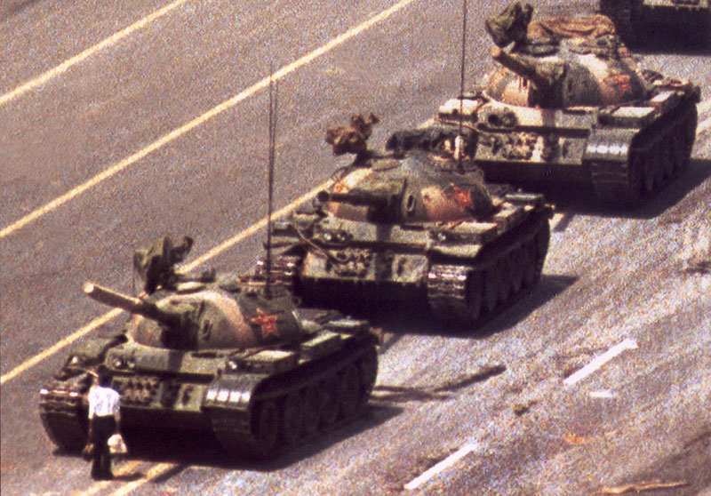
No guarantees
Nonviolence and violence both succeed and both fail
Place your bets and make your commitments

Slide 38
Further research
Inoculants against spoilers/agents provocateurs
External civil society response to violence
Image importance
Image creation
Image defense
Image repair
FMI: pcwtom@gmail.com

