Slide 1
Can Civil Resistance End Civil Wars?
Lessons From Nepal on Combining Nonviolent Struggle
and Peacebuilding Efforts
Subindra Bogati | Nepal Peacebuilding Initiative
Ches Thurber | Northern Illinois University
ICNC Webinar — December 13, 2018
Notes:
thank you for the opportunity to present to you today, excited to talk to you about Nepal
My name is Ches Thurber, I’m AP at NIU, working on a book called “Between Mao and Gandhi: The Social Roots of Civil Resistance”
Working with Subindra Bogati, who runs NPI,
When ICNC said that they were looking for teams of scholars and practitioners, esp international, to conduct case studies on the intersection of CR and PB, and that they were especially interested in case of Nepal, we jumped at the opportunity

Slide 2
Webinar Agenda
Nepal’s Maoist Conflict
Framework for Peacebuilding and Civil Resistance
Applying the Framework to Nepal’s Conflict
Lessons from Nepal for CR and Peacebuilding
Discussion
Notes:
Here’s how I plan to proceed today, and I promise to try to make this brief, so that you can ask some questions and so that I don’t cut into Maciej’s time!

Slide 3
The Economist: Combatant Fatalities in Civil Wars
NEPAL’S
CIVIL WAR
1996-2006
10k Combatant Fatalities
17k Civilian Fatalities
Notes:
Here it is in greater depth
My background is stronger in CR than PB, so I found this useful in that by comparing the two, she shines light on blind spots of CR
One is the problematic nature of this “pro-justice” stance (who gets to define it? A repertoire that can be used by anyone regardless of agenda)
That civil resistance is destabilizing even if non-violent
Not a lot of thought toward how it ends, think about victory/success

Slide 4
Civil War Bookended by Civil Resistance
1990: Civil Resistance Campaign
1996-2006: Maoist Insurgency
April 2006: Civil Resistance Campaign
November 2006: Comprehensive Peace Agreement

Slide 5
Puzzling Questions
How were armed Maoists convinced to transition to nonviolent civil resistance?
How and why did civil resistance succeed where violence could not?
What accounts for the successes and failures of the subsequent peace process driven by civil resistance and peacebuilding strategies?

Slide 6
Integrating CR and Peacebuilding?
CR and PB share a common commitment to social change through nonviolent means
But they have different theories of the drivers of conflict and the pathways to achieving that change
Dudouet identifies ways in which CR and PB strategies can complement each other through 4 stages of conflict
Notes:
Here’s the project that started it all: a special report commissioned by ICNC, written by Veronique Dudouet that attempts to develop a framework for thinking about the integration of civil resistance and Peacebuilding strategies
Starts with idea of common commitments
Different theories of conflict origins and purpose
Oversimplifying a little: PB tries to prevent or resolve conflict, CR sees conflict as necessary in cases of power asymmetries in order to achieve justice

Slide 7
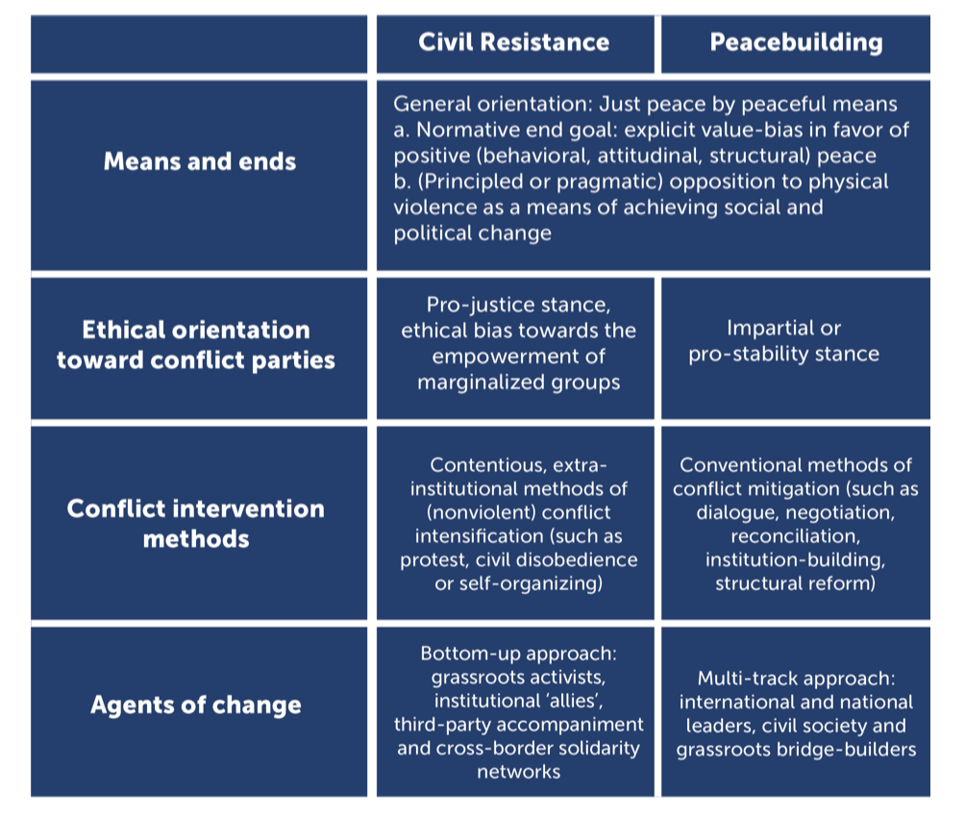
Dudouet: Contrasting CR and PB
Notes:
Here it is in greater depth
My background is stronger in CR than PB, so I found this useful in that by comparing the two, she shines light on blind spots of CR
One is the problematic nature of this “pro-justice” stance (who gets to define it? A repertoire that can be used by anyone regardless of agenda)
That civil resistance is destabilizing even if non-violent
Not a lot of thought toward how it ends, think about victory/success

Slide 8
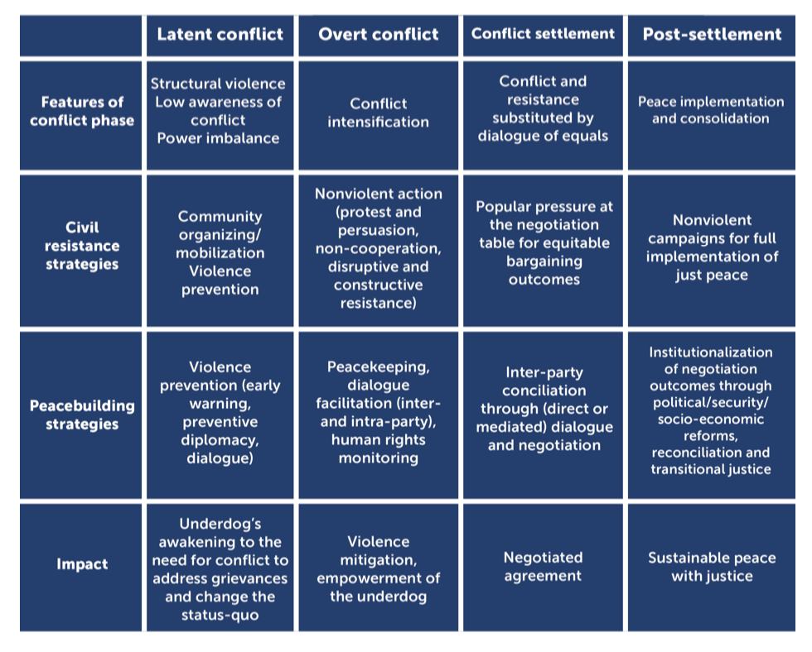
CR and PB Across Four Stages of Conflict
Notes:
Divides conflict into four stages (which I think comes from conflict transformation literature)
Discusses how CR and PB strategies can be used in tandem
“Constructive conflict” : See this synthesis between conflict being an important part of the story (not trying to prevent or hasten the termination of overt conflict) and PB strategies to maintain adherence to NV discipline, to maintain dialogue between actors, create pathways to negotiated settlement, and ensure institutionalized outcomes that can lead not just to toppling a dictator but forging positive peace in the longer term

Slide 9
 | PHASE I : LATENT CONFLICT (1990-1996)
Features of Conflict Phase | High levels of structural inequalities Political social and economic exclusion on the basis of ethnicity, religion, region and caste
Civil Resistance Strategies | Increase in community organizing and civil society Marginalized groups met with repression in country’s periphery
Peacebuilding Strategies | Little dialogue or violence prevention as elites do not believe marginalized groups present a political challenge
Impact | Spreading awareness of injustice (heightened expectations) fuels sense of grievance and demand for change

Slide 10
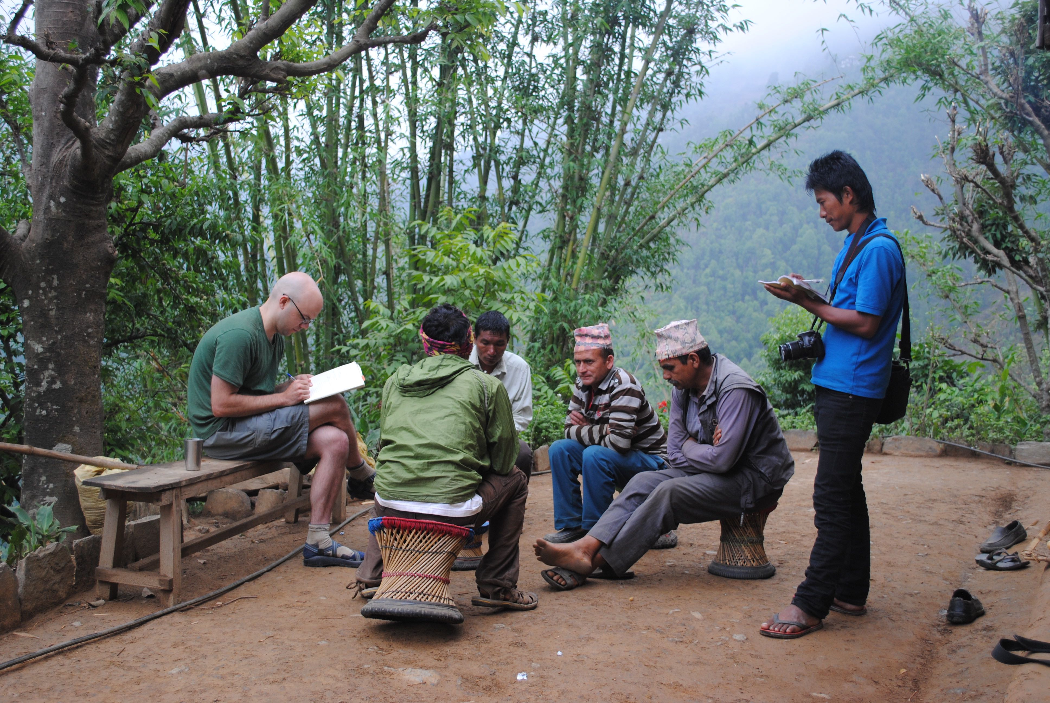
“Nobody listens to the weak people’s voice. . . this thought pointed me towards armed struggle.” - Maoist student wing leader Rolpa, Nepal, May 2014
From Latent to Overt Conflict

Slide 11
“We didn’t turn to guns like fools. We first raised our voice peacefully, but the government ignored us. . . We raised our voice through mass mobilization for people’s rights. We did an ‘andolan’ in Rolpa’s headquarters. We did an ‘andolan’ against the Mahakali treaty. . . We tried different ways of raising our voice. . . but they didn’t listen to that.” - Maoist village leader in Rolpa, Nepal (Interview conducted May 2014)
From Latent to Overt Conflict

Slide 12
 | PHASE II : OVERT CONFLICT (1996-2006)
Features of Conflict Phase | Ten years of violent insurgency that kills 17,000 19 days of civil resistance that leads to peace negotiations
Civil Resistance Strategies | 17 days of mass protest and general strike made possible by cooperation between political parties and Maoist insurgents
Peacebuilding Strategies | Efforts at negotiation throughout latter half of civil war Transition to Civil resistance made possible by negotiated agreement between political parties and Maoists Heavy Indian involvement
Impact | King agrees to restore parliamentary democracy Political parties agree to negotiate with Maoists for permanent settlement

Slide 13
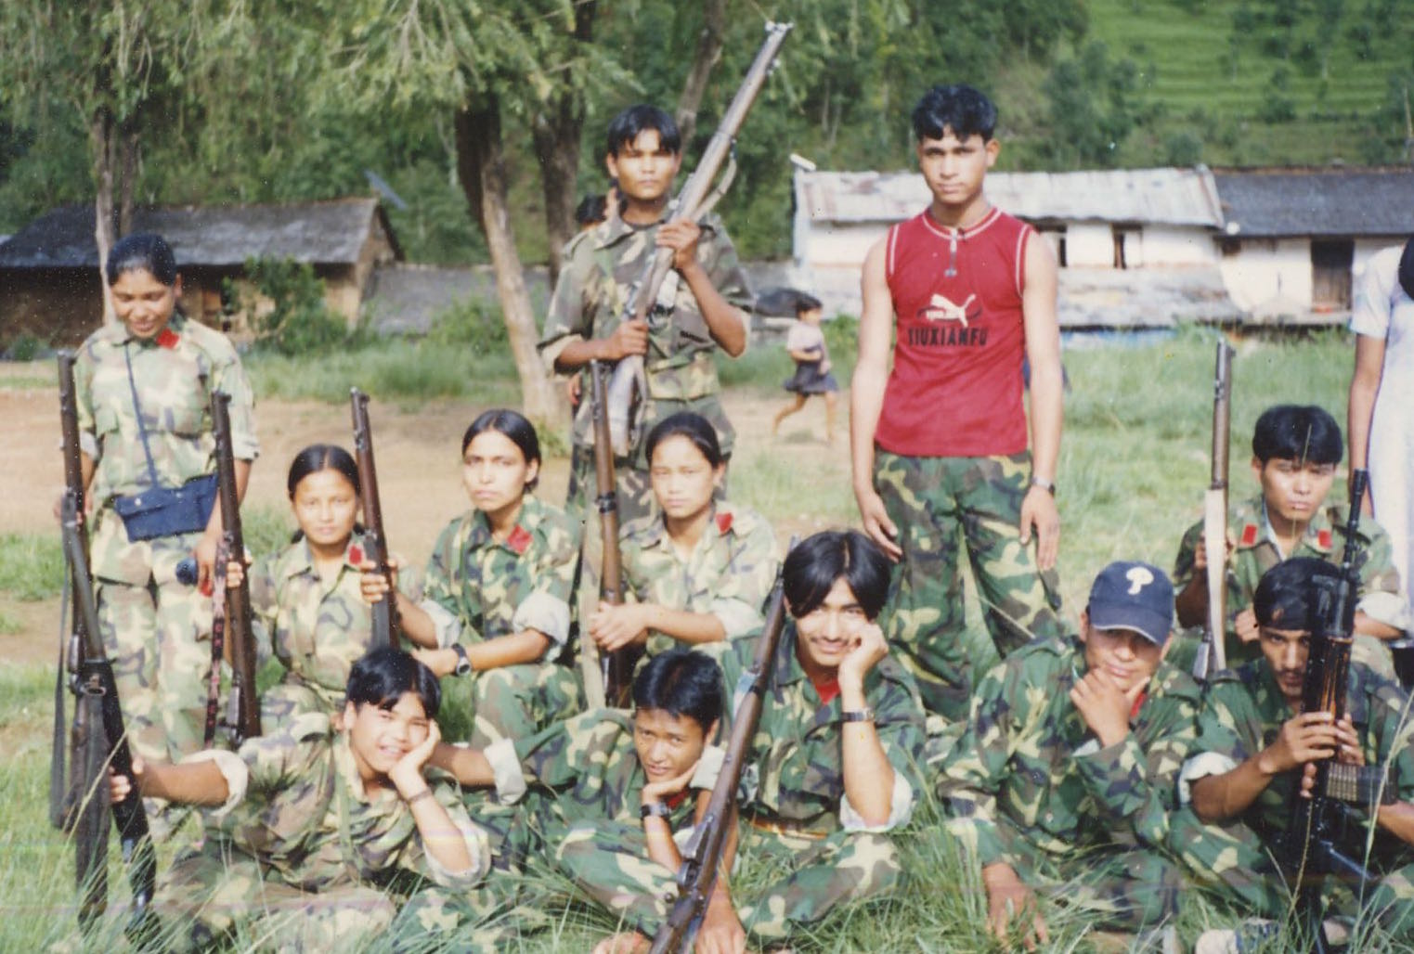
Faces of the People’s War (Credit: Subodh R. Serpali)

Slide 14
Faces of the Loktantra Andolan (Credit: Saurabh Das, AP)

Slide 15
 | PHASE III : CONFLICT SETTLEMENT (2006)
Features of Conflict Phase | Several months of negotiations between Maoists and political parties leading to Comprehensive Peace Agreement
Civil Resistance Strategies | Little use of popular pressure in this phase, the main leverage was a threatened return to armed violence
Peacebuilding Strategies | Dialogue focused primarily on political next steps, rather than durable solution to underlying conflict issues Both sides preparing for a transformation to political competition
Impact | Successful completion of peace agreement, but many of the most contentious issues deferred to constitution-writing process

Slide 16
Signing the Peace Treaty

Slide 17
Continued Protests… (Credit: Puja Sen)

Slide 18
 | PHASE IV : POST-SETTLEMENT
Features of Conflict Phase | Continued instability as actors unable to agree on a constitutional framework or transitional justice Frequent nonviolent mobilization
Civil Resistance Strategies | All actors frequently turn to protest and strike tactics as a way of trying to gain leverage in political negotiation Creates backlash against marginalized groups
Peacebuilding Strategies | Continued efforts at dialogue, both in parliament and communities supported by substantial international assistance IC accused by Nepali elites of fomenting conflict
Impact | Nepal has experienced no return to civil war, but continued political and social instability Many grievances of marginalized groups remain unaddressed

Slide 19
Lessons
Dudouet framework especially helpful in thinking through period of latent conflict and how it led to violence
Nepal’s Civil Resistance campaign a textbook example of the potential for CR + PB = “constructive conflict”
In violent conflicts, can a transition to civil resistance be an alternative goal for peacebuilders rather than a peace agreement?
Mixed lessons from the Conflict Settlement and Post-Settlement Phases:
The CS phase did NOT follow PB best practices
Not sure if that was a good or a bad thing…

